Slide 1
jellyfish tank
johan steven ospina arroyave

Slide 2
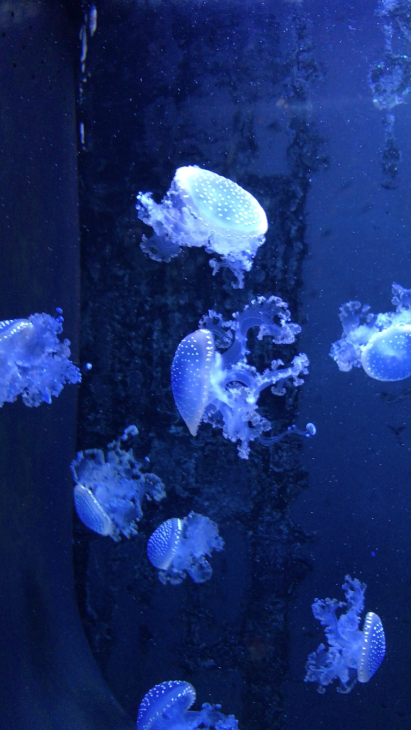

Inspiration
- Video of jellyfish taken at the Plymouth aquarium
- Larsberg Hexanemone:
http://www.larsberg.net/#/hexanemone

Slide 3
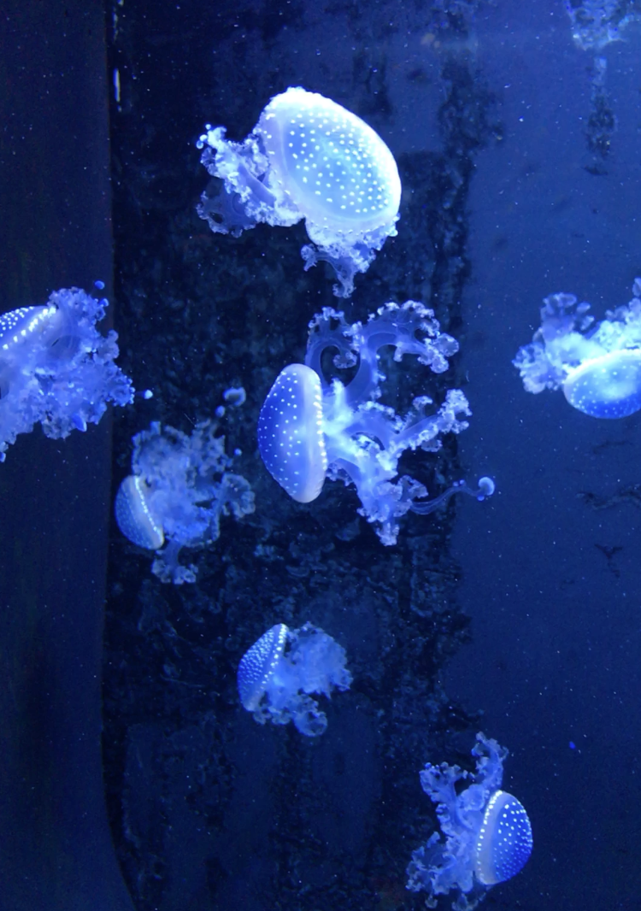
Main project features wishlist
Jellyfish randomly floating in the canvas
Particles floating around to simulate the effect from the video
User interaction: The jellyfish will float towards either the mouse pointer or to wherever the user clicks within the canvas.

Slide 4
Resources to be used
Three.js
Cannon.js (maybe) - It’s a a physics engine, written in JavaScript that would allow fluent movement to the Jellyfish

